Slide 2

What is Hadoop
Hadoop is an open source framework from Apache and is used to store process and analyze data which are very huge in volume. Hadoop is written in Java and is not OLAP (online analytical processing). It is used for batch/offline processing. It is being used by Facebook, Yahoo, Google, Twitter, LinkedIn and many more. Moreover it can be scaled up just by adding nodes in the cluster.

Slide 3
Modules of Hadoop
HDFS: Hadoop Distributed File System. Google published its paper GFS and on the basis of that HDFS was developed. It states that the files will be broken into blocks and stored in nodes over the distributed architecture.
Yarn: Yet another Resource Negotiator is used for job scheduling and manage the cluster.

Slide 4
3. Map Reduce: This is a framework which helps Java programs to do the parallel computation on data using key value pair. The Map task takes input data and converts it into a data set which can be computed in Key value pair. The output of Map task is consumed by reduce task and then the out of reducer gives the desired result.
4. Hadoop Common: These Java libraries are used to start Hadoop and are used by other Hadoop modules.

Slide 5
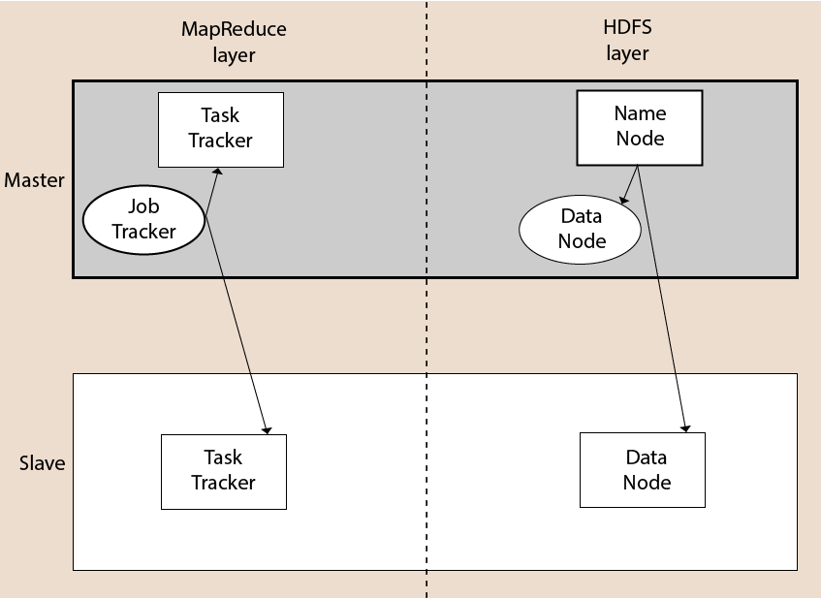
Hadoop Architecture
A Hadoop cluster consists of a single master and multiple slave nodes. The master node includes Job Tracker, Task Tracker, NameNode, and DataNode whereas the slave node includes DataNode and TaskTracker.

Slide 6
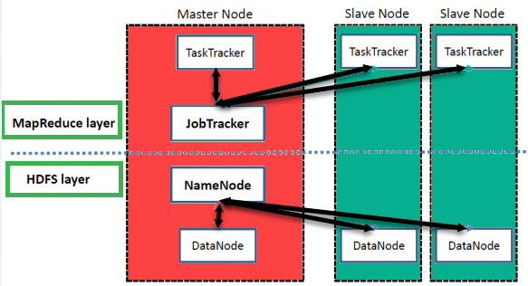
Hadoop Architecture

Slide 7
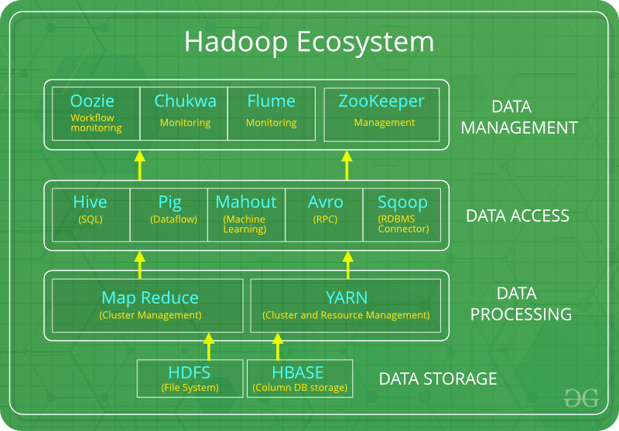
Hadoop and its Ecosystem

Slide 8
Advantages of Hadoop
Fast
Scalable
Cost Effective
Resilient to failure

Slide 9
Hadoop Distributed File System
The Hadoop Distributed File System (HDFS) is a distributed file system for Hadoop. It contains a master/slave architecture. This architecture consist of a single NameNode performs the role of master, and multiple DataNodes performs the role of a slave.
Both NameNode and DataNode are capable enough to run on commodity machines. The Java language is used to develop HDFS. So any machine that supports Java language can easily run the NameNode and DataNode software.

Slide 10
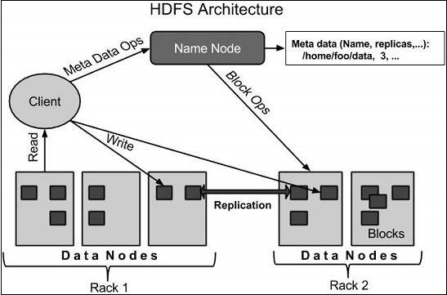

Slide 11
NameNode
It is a single master server exist in the HDFS cluster.
As it is a single node, it may become the reason of single point failure.
It manages the file system namespace by executing an operation like the opening, renaming and closing the files.
It simplifies the architecture of the system.

Slide 12
DataNode
The HDFS cluster contains multiple DataNodes.
Each DataNode contains multiple data blocks.
These data blocks are used to store data.
It is the responsibility of DataNode to read and write requests from the file system's clients.
It performs block creation, deletion, and replication upon instruction from the NameNode.

Slide 13
Job Tracker
The role of Job Tracker is to accept the MapReduce jobs from client and process the data by using NameNode.
In response, NameNode provides metadata to Job Tracker.
Task Tracker
It works as a slave node for Job Tracker.
It receives task and code from Job Tracker and applies that code on the file. This process can also be called as a Mapper.

